Slide 1
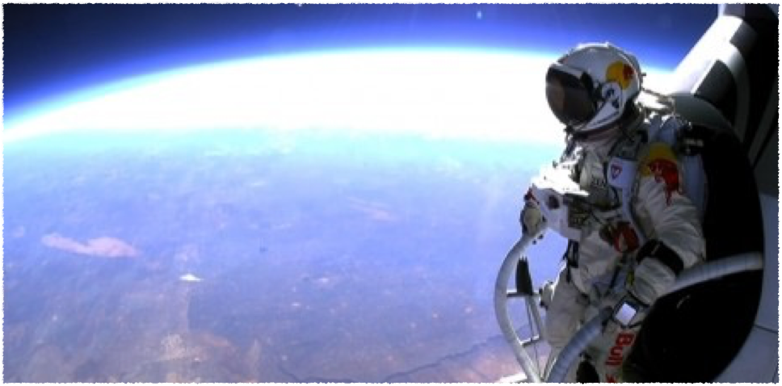
TCP Connections
The High-Level View

Slide 2

UDP Problems
Packets have to be resent
Packets arrive duplicated or out of order
Have to split data across packets
Can overwhelm connection
Notes:
Packets have to be resent
- Lost or corrupted
Packets arrive out of order
-
Have to split data across packets
- May not even be able to predict how splitting needs to happen; minimum MTU, or try for bigger and scale back?
Can overwhelm connection
WHAT IF I TOLD YOU…

Slide 3
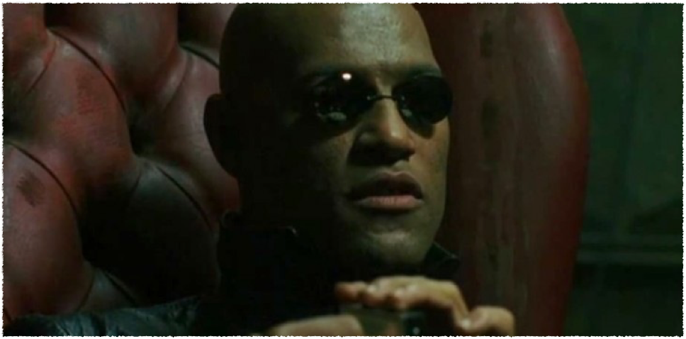
…there is a better way

Slide 4
TCP Solutions
Packets are promised to arrive
Duplicate/out-of-order packets dropped
Data stream split into packets automatically
Packets are throttled to not overload network
Notes:
Guaranteed delivery
In sequence
Automatic splitting
Congestion control

Slide 5
Why Not?
Not all packets equally valuable
Duplicate packets are a warning sign
Your data may be pre-segmented
Games can afford to be bad citizens
Notes:
Guaranteed delivery
In sequence
Automatic splitting
Congestion control

Slide 6
UDP State Machine
Incoming Packet
Port open?
No
Discard Packet
Yes
Buffer available?
No
Yes
Deliver Packet

Slide 7
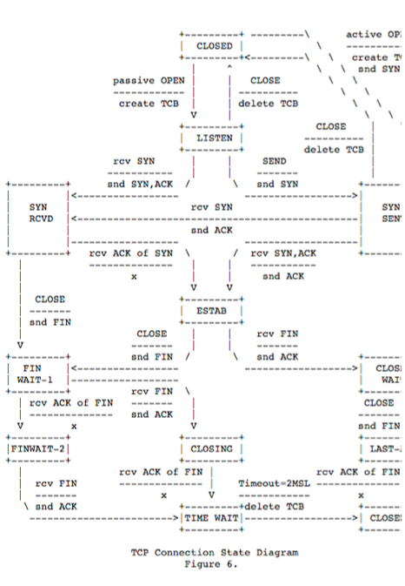
TCP State Machine

Slide 8
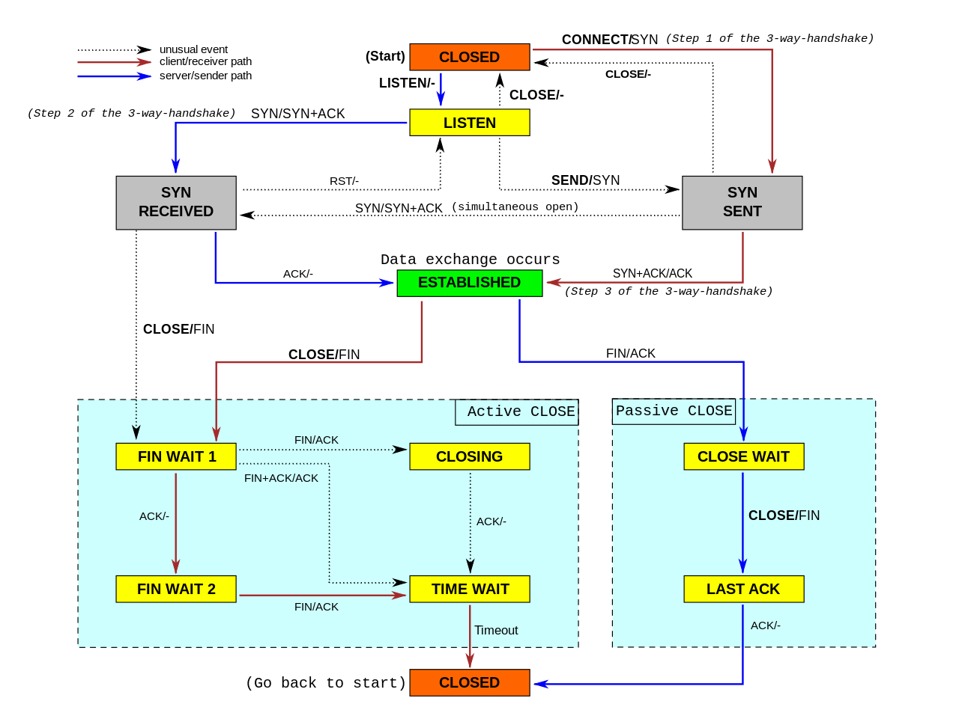


Slide 9

Server
Send message & start timer
Client

Slide 10

Server
Send message & start timer
Client
Receive message
Send ACK

Slide 11


Server
Send message & start timer
ACK received!
Send message & start timer
Client
Receive message
Send ACK

Slide 12
Server
Send message & start timer
ACK received!
Send message & start timer
Timer expired
Client
Receive message
Send ACK

Slide 13

Server
Send message & start timer
ACK received!
Send message & start timer
Timer expired
Resend message & restart timer
Client
Receive message
Send ACK

Slide 14
Server
Send message & start timer
ACK received!
Send message & start timer
Timer expired
Resend message & restart timer
Client
Receive message
Send ACK
Receive re-sent message
Send ACK

Slide 15

Server
Send message & start timer
ACK received!
Send message & start timer
Timer expired
Resend message & restart timer
ACK received!
Send message & start timer
Client
Receive message
Send ACK
Receive re-sent message
Send ACK

Slide 16
Server
Send message & start timer
ACK received!
Send message & start timer
Timer expired
Resend message & restart timer
ACK received!
Send message & start timer
.
.
.
Client
Receive message
Send ACK
Receive re-sent message
Send ACK
.
.
.

Slide 17
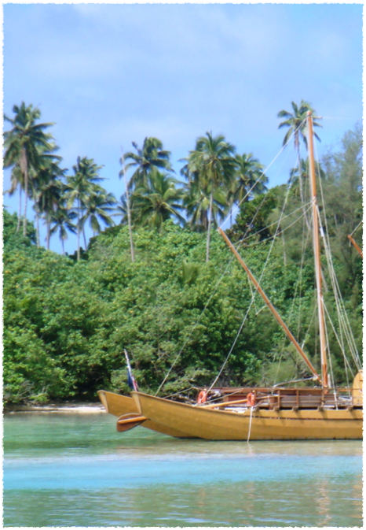
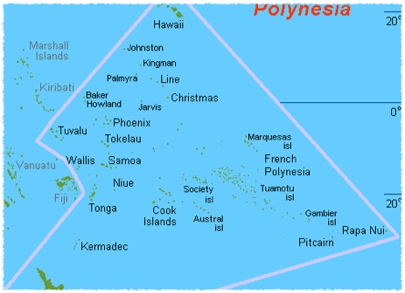
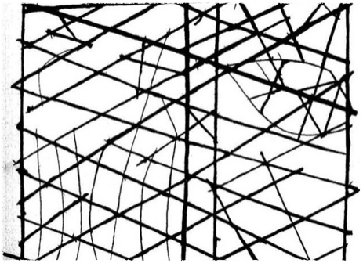
Notes:
Okay, so let’s talk about ACKing and windows and whatnot for a minute. [CLICK] I’m going to talk for a minute about how eastern Polynesia was settled. This is going to seem like a digression, but y’all just have to trust me. [CLICK] The dates are fuzzy, but basically western Polynesia—the Samoa area—where the islands are relatively close together, were all settled from the west about 3000 years ago. They paused for about a thousand years, then started pushing east again, arriving at the eastern edges like Hawaii and Rapa Nui maybe a thousand years ago. Now, they were amazing navigators—[CLICK] this is one of their maps; the straight lines are winds, the curves are waves, the oval up there is an island—but they didn’t know where the next island was. At best they could guess, based on what direction migrating birds flew in.
So imagine what migration was like: Some adventurous vaka crew would set out. The ocean is a big empty place, so you have to figure that most of the time they turn around and head home, maybe they hit a storm, maybe they miscalculate and turn back home too late. Sometimes they reach land, settle it, and now they send back home to tell them that there’s a new island to travel to. At that point, everyone updates their maps and now traders and travelers can start going back and forth. And if it looks like “hey, no big deal”—that distance right there, Pitcairn to Rapa Nui? That’s 1,300 miles. So what’s this got to do with TCP? Well remember in week 1, talking about time, the round-trip time from a computer’s perspective is 10 years. So your RSFTP client is like the Polynesian explorers—it doesn’t send out another packet until it knows what happened to the first one, and that takes a long time. TCP isn’t like that. TCP is what happens after the map’s been updated—there’s lots of canoes in the water at once. It does this because waiting for an ACK after every single packet would be way way way too slow.
So the moral of this story is that your human-scale intuitions are going to fail you if you’re not careful. You’ll say “well, the ACK happens instantly, so why not keep things simple and just wait for the ACK to come back.” If you really appreciated computer time, and understood that the ACK takes TEN YEARS to come back—like those Polynesian wayfinders—then you’d look for ways to avoid having to wait.

Slide 18
Little’s Law (John Little, MIT, 1954)
Occupancy = Latency x Throughput
count = count/time x time
O = L x T ⬅➔ L = O / T ⬅➔ T = O / L
Notes:
Guaranteed delivery
In sequence
Automatic splitting
Congestion control

Slide 19

Server
Send message 1
Client
Notes:
We saw from the Polynesia digression that this one-at-a-time process is much too slow. Message packets are way less valuable than exploration canoes; we can afford to take some risks with them. So we’re going to do two things. First, we’re going to send multiple packets at a time, like this…

Slide 20

Server
Send message 1
Send message 2
Client

Slide 21

Server
Send message 1
Send message 2
Client
Receive & ACK 1

Slide 22

Server
Send message 1
Send message 2
Client
Receive & ACK 1
Receive & ACK 2

Slide 23
Server
Send message 1
Send message 2
1 ACKed; send 3
Client
Receive & ACK 1
Receive & ACK 2

Slide 24
Server
Send message 1
Send message 2
1 ACKed; send 3
2 TIME; resend 2
Client
Receive & ACK 1
Receive & ACK 2

Slide 25
Server
Send message 1
Send message 2
1 ACKed; send 3
2 TIME; resend 2
Client
Receive & ACK 1
Receive & ACK 2
Receive & ACK 3

Slide 26
Server
Send message 1
Send message 2
1 ACKed; send 3
2 TIME; resend 2
Client
Receive & ACK 1
Receive & ACK 2
Receive & ACK 3
:( ACK 3 (&2); LIMIT=1
Notes:
Point out that ACKing 3 automatically ACKs 2; there’s a TCP improvement called “selective ACKing” that could ACK 3 but not 2, but by default any ACK is an ACK for all prior packets.

Slide 27
Server
Send message 1
Send message 2
1 ACKed; send 3
2 TIME; resend 2
3 & 2 ACKed; send 4
Send 5
Client
Receive & ACK 1
Receive & ACK 2
Receive & ACK 3
:( ACK 3 (&2); LIMIT=1

Slide 28
Server
Send message 1
Send message 2
1 ACKed; send 3
2 TIME; resend 2
3 & 2 ACKed; send 4
Send 5
Set new LIMIT=1
Client
Receive & ACK 1
Receive & ACK 2
Receive & ACK 3
:( ACK 3 (&2); LIMIT=1

Slide 29

Server
Send message 1
Send message 2
1 ACKed; send 3
2 TIME; resend 2
3 & 2 ACKed; send 4
Send 5
Set new LIMIT=1
Client
Receive & ACK 1
Receive & ACK 2
Receive & ACK 3
:( ACK 3 (&2); LIMIT=1
Receive & ACK 4

Slide 30
Server
Send message 1
Send message 2
1 ACKed; send 3
2 TIME; resend 2
3 & 2 ACKed; send 4
Send 5
Set new LIMIT=1
4 ACKed; limit reached; wait
Client
Receive & ACK 1
Receive & ACK 2
Receive & ACK 3
:( ACK 3 (&2); LIMIT=1
Receive & ACK 4

Slide 31

Packets sent and ACKed
Packets sent but not yet ACKed
Packets not yet sent but valid to send
Packets not yet sent and invalid to send
Notes:
Four “buckets”
[WHITEBOARD]

Slide 32
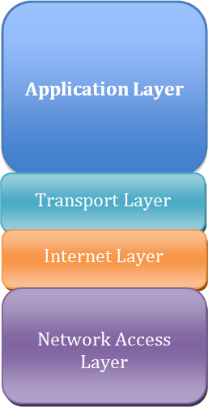
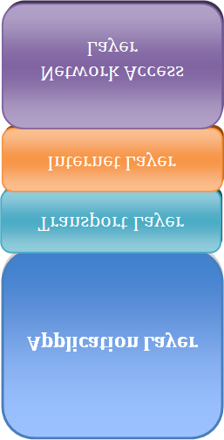
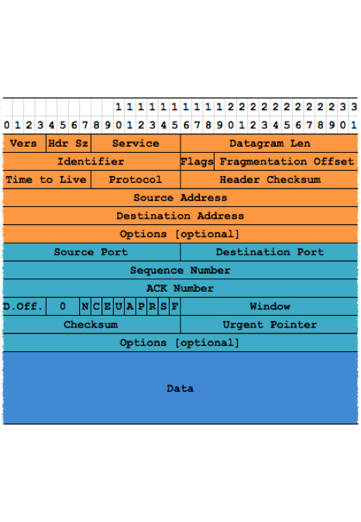
Sequence Numbers
Notes:
Sequence numbers, just like you’re doing in RSFTP.
[CLICK] Both inbound and outbound in the same packet.
Unlike RSFTP, TCP accepts and ACKs incoming packets out of sequence. It then holds them in memory until time to deliver them.

Slide 33
Sliding Windows
Notes:
In RSFTP, you just pick a packet size and stick with it, win or lose. [CLICK] TCP watches the packets and decides how big a packet it can use. It also communicates information about how much data the operating system can handle.
Note that this is an example where, even though it’s technically possible to implement TCP atop UDP, in practice the OS’s implementation will always be superior. The OS doesn’t tell you how much buffer memory is available, but the OS’s TCP implementation knows. So TCP can actually tell the remote machine to slow down sending because the local machine’s memory is getting over-full; a UDP-based protocol doesn’t have that option.

Slide 34
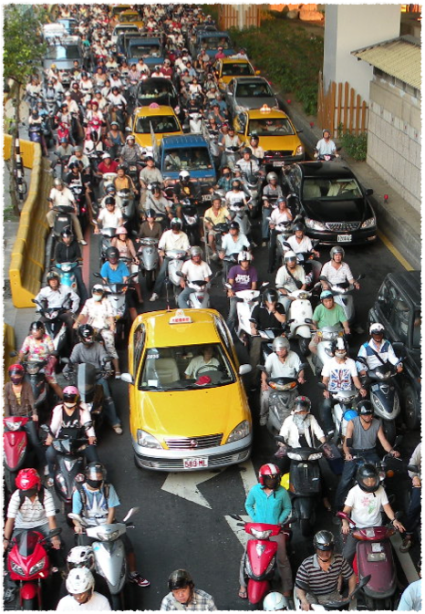
Congestion Control
Notes:
So now we understand why TCP doesn’t just conservatively wait for each packet to be ACKed. But here’s the danger of that—if the sender fires off more packets than the receiver can handle, they’ll gum up the system. So the far end has to have a way to tell the sender to slow down. And, for that matter, routers along the way need a way to tell the sender to slow down, because maybe packets can’t even get through to the recipient so that it knows to tell the sender to slow down.

Slide 35
This page intentionally left blank.

Slide 36
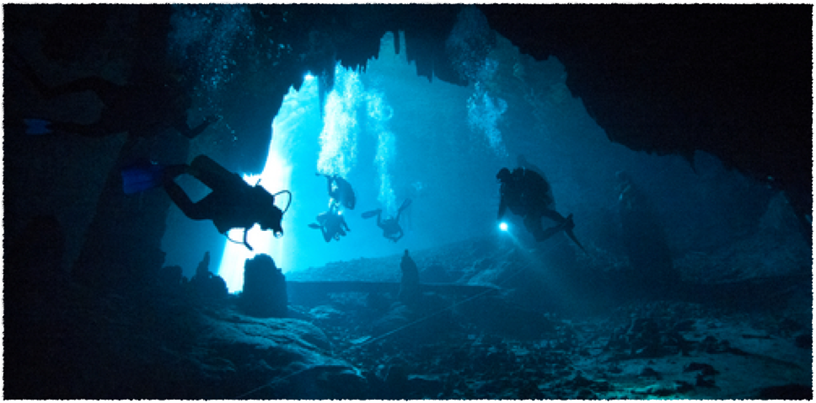
TCP Connections
The Deep Dive

Slide 37
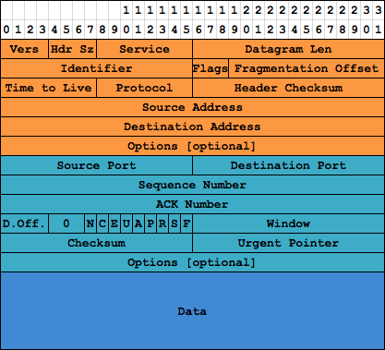
Notes:
Got a lot to cover, not sure how to organize it. May wind up flipping back and forth a lot…

Slide 38
Notes:
TCP has port numbers, just like UDP. But let’s think about that: Since the port numbers are here in the TCP header, that means they’re part of the TCP protocol… which means that, technically, UDP and TCP ports are not the same. This confuses a lot of people. Just because the ports have the same 16-bit range doesn’t mean they’re the same thing. TCP ports are not UDP ports.

Slide 39
Notes:
Let’s skip around some in the packet, so that we get all the easy stuff out of the way. This is the checksum, works just like the UDP checksum to ensure that truncated or corrupted packets are discarded.

Slide 40
Notes:
These are one-bit flags that control various features. Mostly they indicate whether a particular field in this structure should be honored. This is the “urgent” flag, indicating that “urgent” (OOB) data exists in the data section, at an offset indicated by the Urgent Pointer field. Since OOB data is basically deprecated, you’ll basically never use this, so we’ll move on.

Slide 41
Notes:
The PUSH flag says “don’t wait, send this data right away!” Sounds awesome, right? Too bad—it doesn’t work anymore.

Slide 42
Notes:
These bits control a feature called Enhanced Congestion Notification. It’s an advanced subject, and it’s mostly added to the packet for you by routers—if the routers in between the two endpoints support it, they’ll modify the packet header en route. So you can ignore these bits.

Slide 43
Notes:
D Off is Data Offset, and it’s just the size of the header in 32-bit dwords. The header could be a variable size because of optional extra values. When there’s one we need to be aware of I’ll mention it; just be aware that, for the most part, the TCP header is just 20 bytes (5 dwords), the IP header is just 5 dwords, and so the usual TCP packet will be around 1360 bytes (1400 MTU minus 40 bytes).

Slide 44
Notes:
Window is used as part of the flow control system, which we’ll come back to later.

Slide 45
Notes:
That leaves the sequence number, ACK number and the rest of the flags. These are what drive the state machine through its various conditions, which is what we’re going to focus on next.

Slide 46
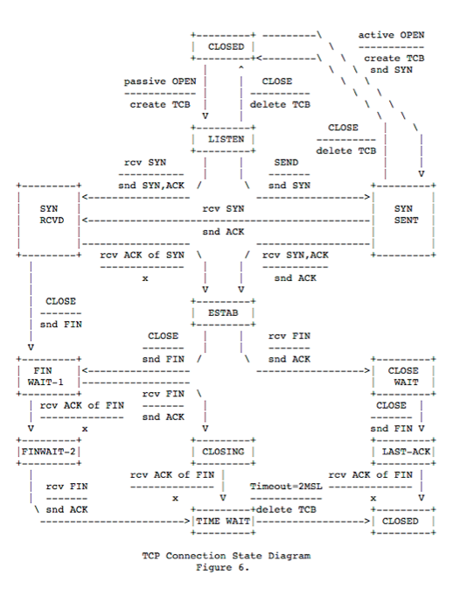
Notes:
So here’s our ASCII graphics diagram… we can do better than this.

Slide 48
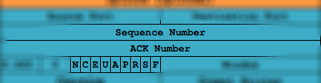
9000
Notes:
The red arrows are client state transitions. They’re not messages, because this isn’t a data-flow diagram, it’s a state machine. The blue lines are server state transitions. The dashed lines are error states—generally we’re just going to ignore those in this talk.
The client begins the process by calling connect(). [CLICK] That sends a TCP packet to the server, with the SYN bit set. [CLICK]
The SYN flag says “hey, let’s get this party started”; it’s like our HELLO in RSFTP. The sequence number here is a 32-bit value randomly picked by the client. Now that’s a really important security feature. [explain why—anyone could send a packet, but they won’t know the next sequence number unless they can see our outbound traffic—and if they can do that, they’re a man-in-the-middle, which is a whole separate problem]
We’ll say our SYN number is 9000. Our packet is away, and now we wait.

Slide 49

4000
9001
Notes:
The server is in LISTEN state. Remember that the OS is actually handling all this, so the server’s state is not visible to our application. But broadly, you can imagine the LISTEN state as the result of the listen() Winsock API call.
The server receives the SYN packet and composes a reply [CLICK]. We need to send the client an initial sequence number, so we’re going to set SYN bit; and we need to ACK the client’s sequence number, so we’re going to set ACK bit.
[CLICK] When we ACK, we send back the previous value plus 1—basically saying “this is the next sequence number I’m ready to receive”. So that’s 9001.
[CLICK] We create an initial sequence number for the client, and again, we pick a random value. Here we’ll say it’s 4000.

Slide 50
Notes:
Having sent our SYN/ACK packet, we’re now in [CLICK] SYN RECEIVED state. Y’all see the parallels to RSFTP, right?

Slide 51
9001
4001
Notes:
Back to the client, in SYN SENT state. [CLICK] It sees the SYN/ACK packet and verifies that the ACK number is exactly one greater than the original value. Yay! Now it sends a packet to ACK the server’s SYN/ACK [CLICK], setting ACK to the expected value of the previous sequence plus 1, or 4001 [CLICK]. It then sets the sequence number of this message to 9001, since it’s the message after the initial 9000 packet. [CLICK]

Slide 52
Notes:
As far as the client is concerned, we’re now in business—it’s in the ESTABLISHED state. In terms of what our application sees, this is the moment that the client returns from the connect() call.

Slide 53
Notes:
The server receives the ACK, and now it’s in ESTABLISHED. [CLICK] This is when accept() returns a new socket representing this particular client connection.
Now, if any part of this handshake fails, the OS will resent the packets. I’m sure you’ve opened a browser and had it just sit with the loading bar far to the left edge—dropped SYN, SYN/ACK or ACK packets are one of the main causes of that.
Okay, the state machine is going to park at this ESTABLISHED state for a while. The actual data transfer back and forth happens within this state. We’ll look at that next. Later we’ll come back to see what happens when the connection is terminated.

Slide 54
9321
[500 bytes of data]
Packets
Packets
Bytes
9821
Notes:
Okay, now I’m going to drop the truth bomb that makes TCP so flexible. You ready?
I’ve been talking about ACKing individual packets, but that’s not what TCP does [CLICK]
TCP ACKs [CLICK] bytes. So that means that when the server, say, [CLICK]
sends 500 bytes of data with a sequence number of 9321…
[CLICK] the client will ACK it with 9821 (because remember, ACKs are “this is the sequence number I will expect to see in your next transmission).

Slide 55
Notes:
The maximum number of bytes that can be “in the air” is set by the WINDOW field.

Slide 56
Flow Control Tricks
Selective Acknowledgement [RFC1072 & RFC2018]
Karn’s Algorithm [RFC2988 & RFC6298]
Slow Start, Congestion Avoidance, Fast Retransmit, Fast Recovery [RFC2581]
Nagle’s Algorithm [RFC896]
Explicit Congestion Notification [RFC3168 and RFC3540]
Notes:
Not going to go into these, but they make really interesting reading. The point of these is that there are a lot of things to think about—how soon you retransmit, how much data you pack into one packet, how quickly you adjust the sliding window, etc. TCP is constantly working to optimize these, but there’s no right answer. You will have to answer these questions if you write a UDP protocol.

Slide 57

Notes:
Okay, back to our state machine. We’re going to see how the connection gets shut down. First, when we were talking about startup, we had to identify the client (initiator of the connection) and server (acceptor of the connection). For shutdown, we need to identify the initiator of the shutdown, who may or may not be the server. So [CLICK] we’ll mark that initiator as GREEN. This is the “ACTIVE CLOSE” side. The application on that machine calls shutdown(socket, SD_SEND), in response to which the OS sends a packet [CLICK] with the FIN bit set.

Slide 58

Notes:
While we’re waiting,w e sit in FIN WAIT 1 state. In this state, we can still receive, because the far end doesn’t know we’re shutdown and can still be sending us data. But we can’t send anything further, and we’ll get an error if we do.
The other end of our connection is going to go through the PASSIVE CLOSE side of the machine. [CLICK] It’ll be marked in peach, or rose, or whatever this color is.
When it receives the FIN, it does two things. First, it ACKs it. [CLICK]

Slide 59
Notes:
Then it notifies the application. Under Winsock, this means that any attempt to read data from the socket will return 0. But that may not happen for a while, and until it does, [CLICK] it sits in CLOSE WAIT.

Slide 60
Notes:
Once the application hears about the closure (by receiving zero bytes), the passive side sends its own FIN packet [CLICK], and moves [CLICK] to LAST ACK state.

Slide 61
Notes:
Back on the active side, when it received the passive side’s ACK of the active FIN, it moved from FIN WAIT 1 to [CLICK] FIN WAIT 2. The application can still receive bytes as they come in.

Slide 62
Notes:
When the active side sees that FIN, it sends back an ACK [CLICK], and then goes to TIME WAIT [CLICK]. Now it just sits for a certain amount of time; it’s not going to wait for an ACK of its ACK, because if it tried to do that we’d be here all day.

Slide 63
Notes:
Once the timeout finishes, the active side is closed. [CLICK] And once the ACK is received, the passive side closes. [CLICK]

Slide 64
Notes:
WE ARE ALMOST DONE
There’s one flag left. The RST or reset flag says the connection is being terminated due to some form of error. There’s a number of ways this can happen; they all show up in your application as WSAECONNRESET.

Slide 65
